Slide 1
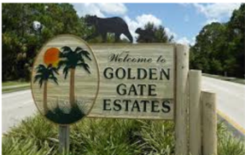
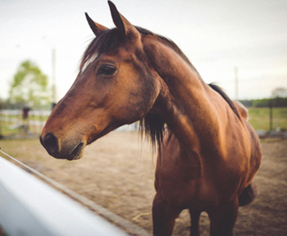
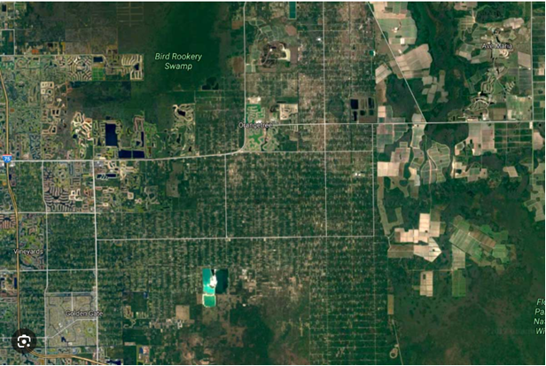

Rural Golden Gate Estates Restudy Advisory Committee
Land Uses
Collier County | Florida
Growth Management Community Development DEPARTMENT
July 22, 2026

Slide 2
AGENDA
Big Corkscrew Island Regional Park
810 39th Avenue, N.E., Naples, FL
Wednesday, July 22, 2026
6:30 p.m. – 8:30 p.m.
1. Pledge of Allegiance
2. Roll Call
3. Approval of Agenda
4. Approval of June 24, 2026, Meeting Minutes (Pending Availability)
5. Old Business
6. New Business
A. Roundtable Discussions: Land Uses in Rural Golden Gate Estates
B. August Meeting Topic - Transportation
7. Public Comments
8. Chair and Committee Member Comments
9. Next Meeting
August 26, 2026, at 6:00 p.m., at Max Hasse, Jr. Community Park
10. Adjourn

Slide 3
ROUNDTABLE DISCUSSIONS
LAND USES IN RURAL GOLDEN GATE ESTATES

Slide 4





Next Steps
Compile Community Feedback
& Prepare Summary for a Future Meeting

Slide 5
AGENDA
Big Corkscrew Island Regional Park
810 39th Avenue, N.E., Naples, FL
Wednesday, July 22, 2026
6:30 p.m. – 8:30 p.m.
1. Pledge of Allegiance
2. Roll Call
3. Approval of Agenda
4. Approval of June 24, 2026, Meeting Minutes (Pending Availability)
5. Old Business
6. New Business
A. Roundtable Discussions: Land Uses in Rural Golden Gate Estates
B. August Meeting Topic - Transportation
7. Public Comments
8. Chair and Committee Member Comments
9. Next Meeting
August 26, 2026, at 6:00 p.m., at Max Hasse, Jr. Community Park
10. Adjourn

Slide 6
Stay Informed
Project webpage: https://www.collier.gov/Collier-County/Advisory-Boards-Authorities/Advisory-Boards/Rural-Golden-Gate-Estates-Restudy-Advisory-Committee
Meeting schedule: August 26, 2026
Contact Information:
Michele Mosca, AICP
(239) 252-2466 or michele.mosca@collier.gov

