Slide 1
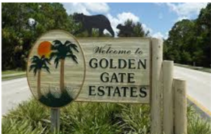
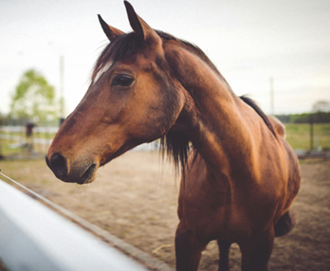
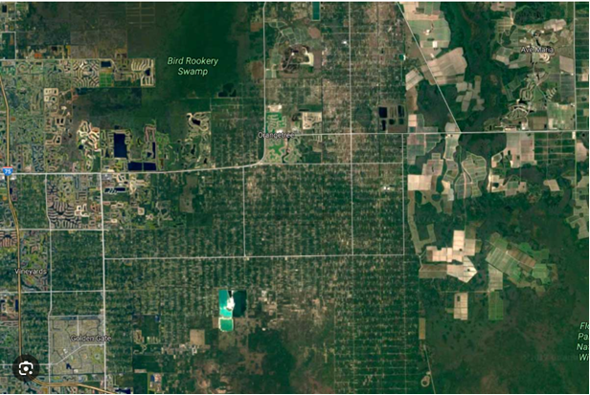

Rural Golden Gate Estates Restudy Advisory Committee
Meeting
Collier County | Florida
Growth Management Community Development DEPARTMENT
Community Planning and Resiliency Division
February 25, 2026

Slide 2
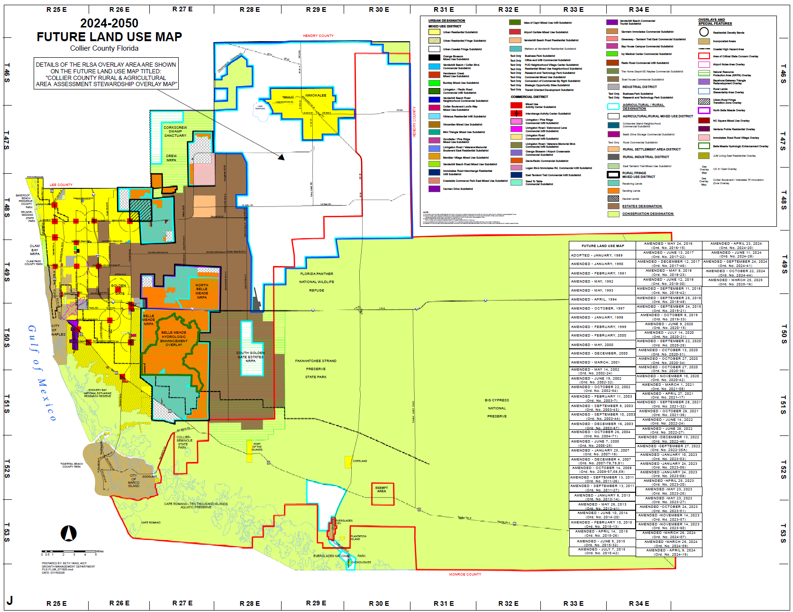
Future Land Use Map

Slide 3
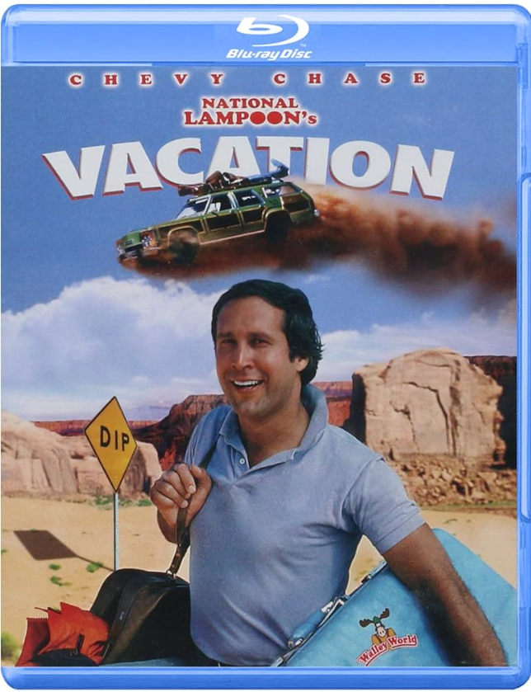
PLANNING --- a plan of action
What steps to take to plan a vacation?

Slide 4
Why Counties Have a Comprehensive Plan
In Florida, counties are required to adopt and maintain a comprehensive plan under the Community Planning Act (Chapter 163, Part II, Florida Statutes). The purpose is to ensure that growth and development are planned, coordinated, and consistent with state law.
Legal Requirement
Manage Growth Responsibly
Provide Predictability and Fairness
Coordinate Public Facilities

Slide 5
The Rural Golden Gate Estates (RGGE) Sub-Element guides how land is used and how growth happens in the community.
Its purpose is to:
Protect the community’s rural character
Make sure development fits the area
Provide needed services and infrastructure
Protect natural resources
Maintain quality of life

Slide 6
Goal | The Vision
Example: Protect rural character and natural resources while accommodating appropriate growth.
Objective | Measurable Outcomes
Example: Limit density and concentrate commercial uses in defined centers.
Policy | The rule
Example: Only allow commercial zoning within the mapped neighborhood centers and prohibit strip commercial development along roadways.

Slide 7
There are 6 GOALS in the RGGE Sub-Element:
Land Use & Public Facilities
Natural Resources & Environment
Commercial Services & Conditional Uses
Rural Character & Community Quality
Transportation & Connectivity
Public Safety & Emergency Services

Slide 8
Goals, Objectives & Policies
GOAL 1:
TO GUIDE LAND USE AND PUBLIC FACILITY DECISION MAKING AND TO BALANCE THE NEED TO PROVIDE BASIC SERVICES WITH NATURAL RESOURCE CONCERNS THROUGH A WELL PLANNED MIX OF COMPATIBLE LAND USES WHICH ENSURE THE HEALTH, SAFETY, WELFARE, AND QUALITY OF LIFE OF THE LOCAL RESIDENTS.
4 Objectives
16 Policies

Slide 9
Goals, Objectives & Policies
GOAL 2:
TO RECOGNIZE THAT THE AREA WHICH LIES SOUTH OF INTERSTATE 75 (ALLIGATOR ALLEY) TO US 41 (TAMIAMI TRAIL) IS AN AREA OF SPECIAL ENVIRONMENTAL SENSITIVITY AND IS BIOLOGICALLY AND HYDROLOGICALLY IMPORTANT THROUGH PARTICIPATION IN THE PICAYUNE STRAND RESTORATION PROJECT AS PART OF THE FEDERAL SAVE OUR EVERGLADES PROGRAM. BASED UPON SUCH CONDITIONS, THE STATE HAS ACQUIRED OWNERSHIP OF ALL LANDS WITHIN THE SOUTHERN GOLDEN GATE ESTATES (SGGE) PICAYUNE STRAND RESTORATION PROJECT AREA.
0 Objectives
0 Policies

Slide 10
Goals, Objectives & Policies
GOAL 3:
TO PROVIDE FOR LIMITED COMMERCIAL SERVICES AND CONDITIONAL USES FOR PURPOSES OF SERVING THE RURAL NEEDS OF GOLDEN GATE ESTATES RESIDENTS, SHORTENING VEHICULAR TRIPS, AND PRESERVING RURAL CHARACTER.
2 Objectives
3 Policies

Slide 11
Goals, Objectives & Policies
GOAL 4:
TO PRESERVE THE AREA’S RURAL CHARACTER, AS DEFINED BY LARGE WOODED LOTS, THE KEEPING OF LIVESTOCK, THE ABILITY TO GROW CROPS, WILDLIFE ACTIVITY, ENVIRONMENTAL STEWARDSHIP, LOW-DENSITY RESIDENTIAL DEVELOPMENT, AND LIMITATIONS ON COMMERCIAL AND CONDITIONAL USES.
3 Objectives
16 Policies

Slide 12
Goals, Objectives & Policies
GOAL 5:
TO PROVIDE FOR A SAFE AND EFFICIENT COUNTY AND LOCAL ROADWAY NETWORK, WHILE AT THE SAME TIME SEEKING TO PRESERVE THE RURAL CHARACTER OF RURAL GOLDEN GATE ESTATES IN FUTURE TRANSPORTATION IMPROVEMENTS WITHIN THE GOLDEN GATE AREA.
3 Objectives
9 Policies

Slide 13
Goals, Objectives & Policies
GOAL 6:
TO PROTECT THE LIVES AND PROPERTY OF THE RESIDENTS OF THE RURAL GOLDEN GATE ESTATES , AS WELL AS THE HEALTH OF THE NATURAL ENVIRONMENT, THROUGH THE PROVISION OF EMERGENCY SERVICES THAT PREPARE FOR, MITIGATE, AND RESPOND TO, NATURAL AND MANMADE DISASTERS.
4 Objectives
12 Policies

Slide 14
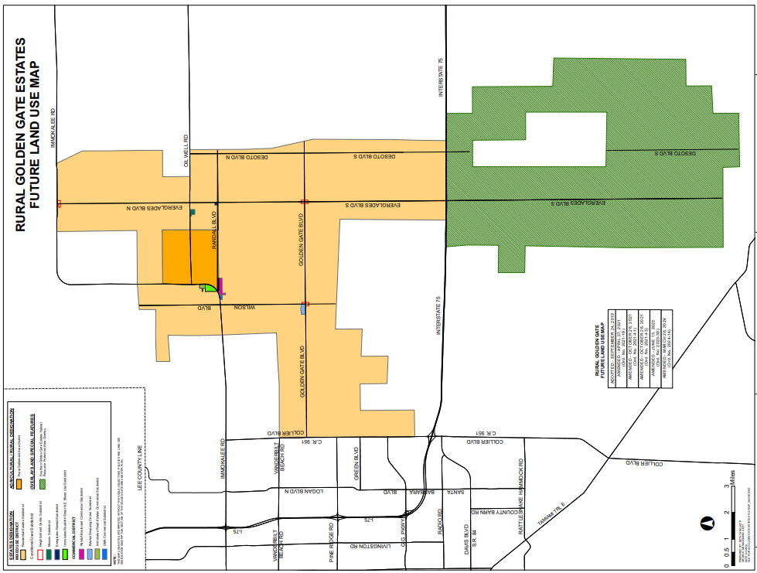
Land Use Description
Section
Estates Designation
Residential Density
1 dwelling unit per 2.25 acres
Exception for legal non-conforming lots
Prohibited Uses
Multi-family units, duplexes, other structures with > 2 dwellings, except in Immokalee Rd./4th Street NE Subdistrict

Slide 15
Land Use Description
Commercial uses are clustered
at major intersections to:
• prevent strip commercial development
• control traffic impacts
• preserve rural character
Design
• Small buildings
• One-story buildings
• Rural architecture (Old Florida style)
• Shared parking and access
• Heavy landscaping buffers
• Pedestrian walkways
• Limited drive-throughs (banks only)
• Unified architectural theme
Prohibited Uses
• Bars & liquor stores
• Hospitals
• Schools & libraries
• Shooting ranges
• Waste facilities
• Homeless shelters

Slide 16
Commercial allowances continued:
Randall Blvd Com’l Sub. - Randall Blvd/Immokalee Rd (Randall Blvd Ctr and Mir Mar PUDs, “E” CU fire station, mostly E; companion DCA)
Estates Shopping Ctr Sub. - GGBlvd/Wilson Blvd NW quad. (Estates Shopping Center PUD)
Immokalee Rd/4th Street N.E. MUS (Randall Curve PUD)
Immokalee Rd-Estates Com’l Sub. – Immokalee Rd between Randall Blvd & Oil Well Rd, opposite Orangetree PUD (BCHD I PUD)
GMA Commercial Subdistrict – Immokalee Rd between Randall & Wilson Blvds (GMA PUD)
Industrial allowances – None

Slide 17
Land Use Description Section
Conditional Use Subdistrict (CU)
Neighborhood Center Transitional CU - criteria includes 75’ buffer requirement with no parking or water mgmt. therein
Transitional CU – abutting commercial zoning or certain other non-residential uses, e.g., fire station; criteria includes parcel size and width, 75’ buffer requirement with no parking or water mgmt. therein
Essential Services CUs allowed anywhere, except as prohibited in Neighborhood Center
CU for Model home & Excavation – allowed anywhere
CU for Cell Tower (site >2.25 acres & on arterial or collector road per Transportation Element)

Slide 18
Agricultural/Rural Designation Rural Settlement Area District
“Vested” for 2,100 DUs, 22 acres of neighborhood commercial, hotel/motel
Addition of DUs or commercial acreage won’t be prohibited or discouraged based on the vested status
Expansion of the District prohibited
Comprised of Orangetree (2,138.8 acs.) & Orange Blossom Ranch (616 acs.) PUDs

Slide 19
Why are we updating the RGGE Sub-Element?
The Sub-Element is being updated to make sure it reflects today’s conditions, community priorities, and future needs.
What decisions does it influence?
The Sub-Element guides decisions about:
Land use and development standards
Commercial and community center locations
Infrastructure such as roads, drainage, and utilities
Environmental protection and natural resource management
Rural design standards and performance criteria
It serves as policy direction for staff, elected officials, and property owners when evaluating development proposals and public investments.
How does it affect residents’ daily lives?
The Sub-Element affects everyday life by shaping:
The look and feel of the community (lot sizes, landscaping, lighting, setbacks)
Traffic patterns and roadway improvements
Availability and location of neighborhood services
Protection of natural areas and wildlife
How growth occurs & how rural character is preserved
In short, it helps balance growth with maintaining the rural lifestyle that residents value.

Slide 20
  Are these Goals accurately reflecting what you want Rural Golden Gate Estates to look like 10–20 years from now?

Slide 21

Public Comment
Community Planning & Resiliency
Division
21

Slide 22
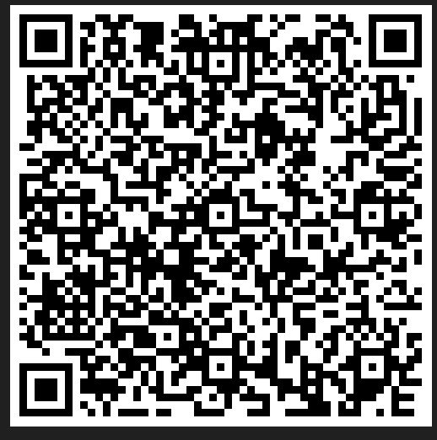
Next Meeting
Web Page
March 25, 2026
6:00 p.m.
Max A. Hasse Jr. Community Park
https://www.collier.gov/Collier-County/Advisory-Boards-Authorities/Advisory-Boards/Rural-Golden-Gate-Estates-Restudy-Committee
22

Slide 23
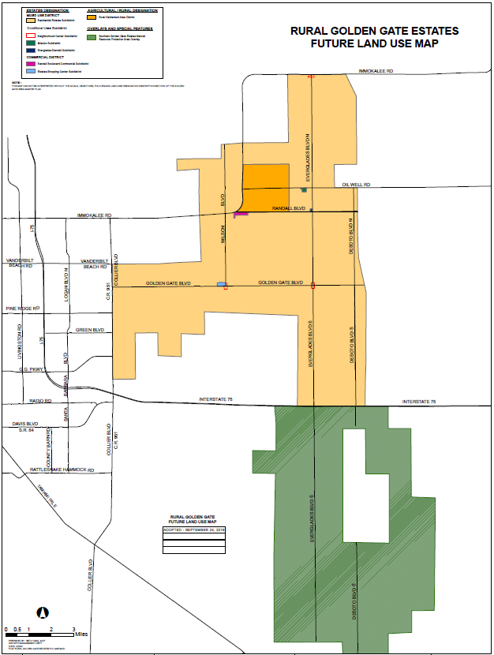

Future Land Use Map

Slide 24
Collier County
Rural Golden Gate Estates Restudy Advisory Committee
AGENDA
Max Hasse Jr. Community Park
3390 Golden Gate Boulevard, Naples, FL
Wednesday, February 25, 2026
6:00 p.m. – 8:00 p.m.
1. Pledge of Allegiance
2. Roll Call
3. Approval of Agenda
4. Approval of January 29, 2026, Meeting Minutes
5. Old Business
A. East of 951 Ad Hoc Advisory Committee “Position Points” Discussion
B. 2026 Meeting Calendar
6. New Business
A. Rural Golden Gate Estates Sub-Element Overview
B. Draft Workplan for the 2026 Calendar Year
7. Chair and Committee Member Comments
8. Public Comments
9. Next Meeting March 25, 2026
10. Adjourn
24

