Slide 1
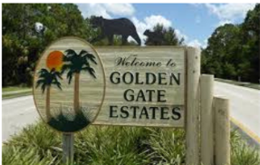
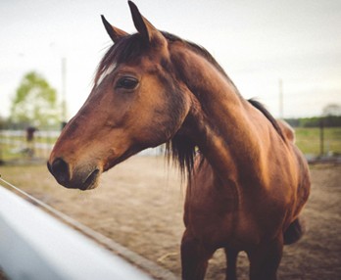
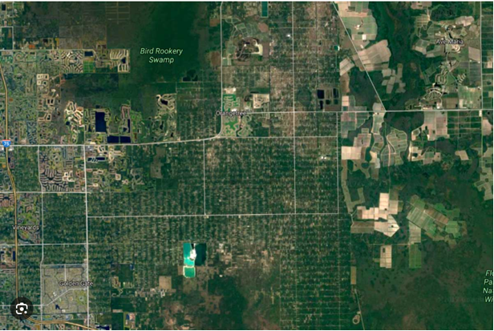

Rural Golden Gate Estates Restudy Advisory Committee
Meeting
Collier County | Florida
Growth Management Community Development DEPARTMENT
Community Planning and Resiliency Division
January 29, 2026

Slide 2
Agenda
1. Call to Order
2. Roll Call
3. Introductions
4. Overview of Rural Golden Gate Estates Restudy
5. Committee Formation, Roles & Responsibilities
6. Selection of Committee Officers
7. Community Engagement
8. RGGE Sub-Element Priorities
9. Future Meetings & Next Steps
10. Public Comment
11. Adjournment

Slide 3
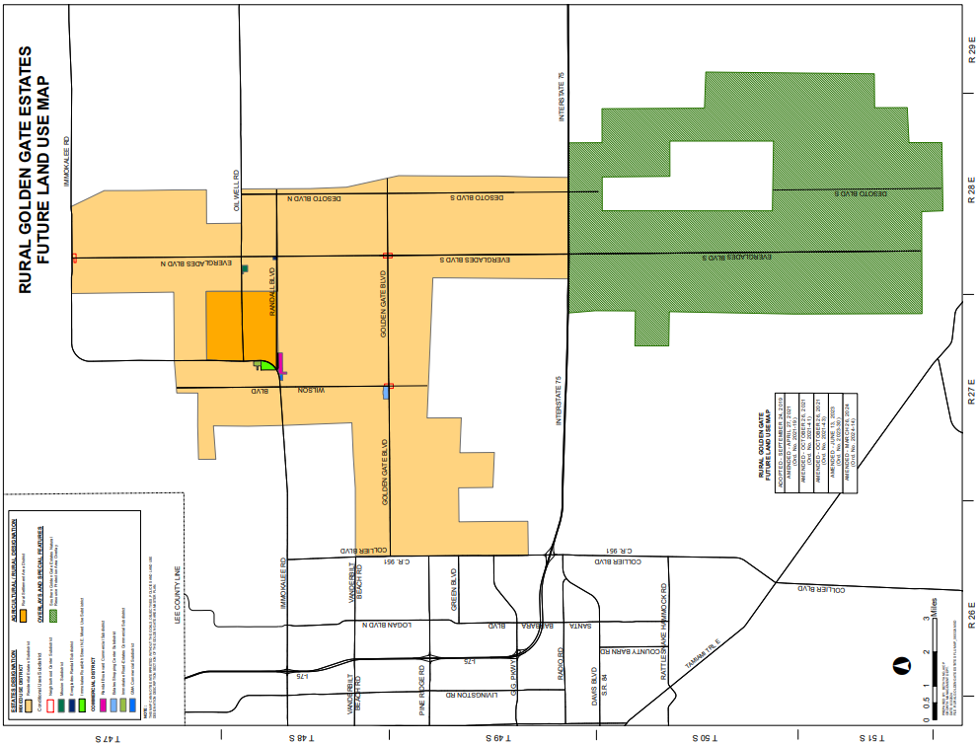
4. Overview
Restudy Area
Background
Project Scope & Objectives
Timelines
Public Engagement
3

Slide 4
5. Committee Formation, Roles, & Responsibilities
Ordinance No. 2025-70
  Primary Source of Community Input
  Identify Issues and relevant
  best practices
  Review studies
  Review proposed amendments
  Review topics of interest identified by the Board

Slide 5
Agenda
1. Call to Order
2. Roll Call
3. Introductions
4. Overview of Rural Golden Gate Estates Restudy
5. Committee Formation, Roles & Responsibilities
6. Selection of Committee Officers
7. Community Engagement
8. RGGE Sub-Element Priorities
9. Future Meetings & Next Steps
10. Public Comment
11. Adjournment

Slide 6
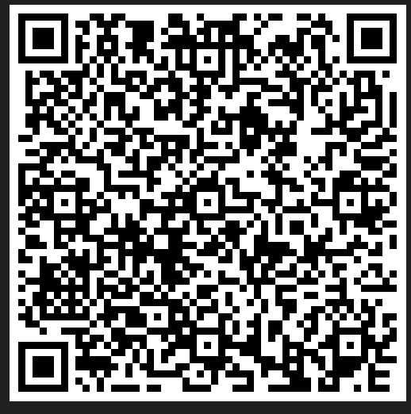
7. Community Engagement &
Public Participation
https://www.collier.gov/Collier-County/Advisory-Boards-Authorities/Advisory-Boards/Rural-Golden-Gate-Estates-Restudy-Committee
6

Slide 7
8. Rural Golden Gate Estates Sub-Element - Priorities
  Goal 1: Coordination of Land Use and Public Facilities
  Goal 2: Picayune Strand Area
  Goal 3: Non-Residential Uses
  Goal 4: Rural Character
  Goal 5: Transportation
  Goal 6: Emergency Mgmt. Planning

Slide 8
Next Meeting
February 18 or 25, 2026
6:00 p.m. or 6:30 p.m.
Max Hasse Community Park
Next Steps
Overview of the Rural Golden Gate Estates Sub-Element
Draft Public Outreach Plan
Draft Committee Work Plan
8

Slide 9

Public Comment
Community Planning & Resiliency
Division
9

