Slide 1
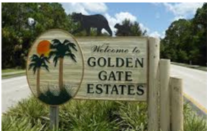
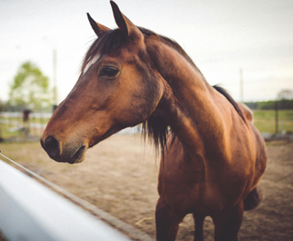
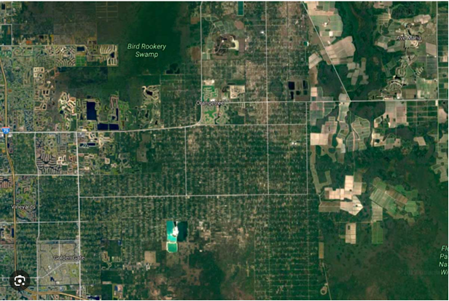

Rural Golden Gate Estates Restudy Advisory Committee
Home-Based Businesses
&
Parking of Commercial Vehicles
Collier County | Florida
Growth Management Community Development DEPARTMENT
June 24, 2026

Slide 2
Purpose
Clarify State Law
Define Regulatory Limits
Identify Community Concerns (To Date)
Community Input

Slide 3
What Collier County CANNOT do under the HBB Law
Prohibit home-based businesses at a residence
Restrict customers visits outright
Restrict retail sales from a residence
Prohibit non-resident employees
Impose additional licensing or regulatory burdens

Slide 4
What Collier County CAN do under the HBB Law
Residential/Visual Appearance
Vehicle, Heavy Equipment & Machinery Visual Impacts
Outdoor Storage
Parking
Signage
Glare/Lighting
Noise, Dust, Odors
Environmental Impacts

Slide 5
HBB
Comments
(March 25, 2026)
Traffic
Noise
Vehicle & Equipment Parking
Visual Clutter/Outdoor Storage
Lighting Impacts
Environmental Impacts
Encourage HBB

Slide 6
Parking of Commercial Vehicles & Equipment
Home-based businesses
Parking of vehicles and heavy equipment can be regulated to prevent visibility from a road and neighboring properties
Properties without a home-based business
Parking of commercial vehicles and equipment is not currently regulated within the Estates

Slide 7









Community Survey

Slide 8
Next Steps
Compile Community feedback
Prepare amendments to address regulations for home-based businesses & the parking of commercial vehicles

Slide 9
Stay Informed
Project webpage: https://www.collier.gov/Collier-County/Advisory-Boards-Authorities/Advisory-Boards/Rural-Golden-Gate-Estates-Restudy-Advisory-Committee
Meeting schedule: July 22, 2026
Contact Information:
Michele Mosca, AICP
(239) 252-2466 or michele.mosca@collier.gov
Public comment opportunity

Slide 10
Back-Up Materials

Slide 11
Definitions
Commercial Vehicle: Any vehicle used in conjunction with a commercial or business activity or possessing the following characteristics. Any motor vehicle not recreational in nature having a rated load capacity of greater than one ton, exceeding 7½ feet in height, 7 feet in width, and/or 25 feet in length. The display of lettering or a similar sign upon a vehicle shall not in and of itself make a vehicle commercial. (LDC)
Commercial equipment: Any equipment used in a commercial business, regardless if the equipment is actually owned or utilized by a business. Commercial equipment shall include the following; earth-moving equipment, landscaping equipment, lawn mowers (push-type or tractor), tillers, ladders, pipes, spools of electric-type wiring or cable, portable pumps, portable generators, pool cleaning equipment and supplies, any trailer not recreational in nature (flat-bed, stake-bed, or fully enclosed), in addition to any other equipment of similar design or function. (LDC)

Slide 12
Definitions
Dwelling Unit: Dwelling (also called dwelling unit): Any building, or part thereof, constituting a separate, independent housekeeping establishment for no more than 1 family, and physically separated from any other rooms or housekeeping establishments which may be in the same structure. A dwelling unit contains sleeping facilities, sanitary facilities, and a kitchen. (LDC)
Home-based Business: A business that operates, in whole or in part, from a residential property and meets the criteria of F.S. 559.955 (F.S. 559.955)

